Slide 1

Attended
Name :
Date:
Notes:
Presenter guidance
Introduce the presentation and what they will learn over the next 30 minutes.
e.g. the following presentation will introduce you to apprenticeships –
About what an apprenticeship is, the different types of apprenticeships available
(2) Discover the benefits and advantages of becoming an apprentice
(3) Explore what goes into an apprenticeship
Background Note
This presentation assumes no prior knowledge of apprenticeships

Slide 2
Message and purpose
Introducing apprenticeships as a future option
About
Discover
Explore
Notes:
Presenter guidance
Introduce the presentation and what they will learn over the next 30 minutes.
e.g. the following presentation will introduce you to apprenticeships –
About what an apprenticeship is, the different types of apprenticeships available
(2) Discover the benefits and advantages of becoming an apprentice
(3) Explore what goes into an apprenticeship
Background Note
This presentation assumes no prior knowledge of apprenticeships

Slide 3

Hands up if you think
you know what an
apprenticeship is...
Notes:
Presenter guidance
Interactive engagement – Discuss
Get the group to volunteer what an apprenticeship is and capture their suggestions

Slide 4
An apprenticeship is a job with substantial training and the development of transferable skills. It is a way for young people to earn while they learn, gaining a real qualification and a real future.
Notes:
Speaker notes:
Young People can ‘get in and go far’ with an apprenticeship at some of Britain’s biggest and brightest companies. They can gain the skills and knowledge they need to succeed, in some cases up to degree level, while working and earning.
Who is an apprenticeship for?
An apprenticeship is available to anyone over 16 years old and living in England
Duration of an apprenticeship
All apprenticeships must be at least 12 months long but can vary in length depending on a number of factors such as existing skills, the framework or standard, and the industry sector or job role.

Slide 5
The benefits are…
Earn a salary
Learn job specific skills
Gain a variety of transferable skills
Work towards nationally recognised qualifications/standards
Progress into higher education
Advance in your chosen career
Notes:
Speaker Notes:
Earn a salary
The national average is £228 per week (according to a national pay survey 2014). But this depends of the area, level of the apprenticeship, sector and experience and can vary between £150 - £400 per week.
The minimum wage an apprentice can earn is £2.73 per hour (as at October 2014) for under 19’s and first year apprentices, £5.13 for 19 and 20 year olds and £6.50 for those aged 21 and over.
Job specific skills
These are skills that apply to the job e.g. a carpenter needs to know how to use the tools of his trade
Transferable skills
Transferable skills could be computer skills or communications skills
Nationally recognised qualifications
A qualification such as a City and Guilds certificate (also : National Vocational qualification (NVQ) and/or BTEC Award, Certificate or Diploma)
Progression
Apprenticeships show a clear path of progression. Higher and degree apprenticeships go right up to masters degree level.
Advance in your chosen career
Employers favour apprenticeships – one third of all apprentices receive a promotion within 12 months of finishing their apprenticeship

Slide 6
Level of apprenticeships
Different levels of apprenticeships available
Intermediate
apprenticeship
Advanced
apprenticeship
Higher & degree
apprenticeships
Level 2
12-18 months
Equivalent to 5 GCSEs A* - C
Level 3
18-48 months
Equivalent to 2 A-levels
Levels 4,5,6,7
24 months+
Equivalent to foundation degree level+
Plus knowledge, competence, and employability skills
Notes:
Speaker notes:
There are 3 levels of apprenticeships
Intermediate Level Apprenticeships – equivalent to 5 A*-C GCSEs
Advanced Level Apprenticeships – equivalent to 2 A-levels
Higher and degree Apprenticeships – equivalent to foundation degree up to masters degree level (4-7)
Apprenticeships have a minimum of 12 months, and can take up to five years to complete depending on the level of apprenticeship, the apprentice`s ability and the industry sector
Additional notes:
When looking for an apprenticeship vacancy you will need to look at the entry criteria e.g. just because you already have GCSE’s at levels A-C does not automatically mean you can apply for an Advanced Apprenticeship in engineering. You would not want an untrained person to service your car or cut your hair so some sectors still require you to start at an introductory level.
Also, A-levels do not automatically mean you can move directly into a Higher or degree Apprenticeship, there may be additional criteria depending on the sector.

Slide 7
Progression
Professional Status
THE
SKY’S
THE
LIMIT
Higher and degree apprenticeships
Level’s 4-7
Entry Points
Entry Points
Advanced apprenticeship
Level 3
Your GCSEs, A-Levels…
Intermediate apprenticeship
Level 2
Entry Points
Traineeships
English and maths qualifications and up to 6 months work experience
Entry Points
Notes:
Speakers notes:
Here is a simple representation of how you can progress on a Traineeship or an Apprenticeship
Traineeship
If you are not quite ready for an Apprenticeship or a job a Traineeship will give you work preparation training
Intermediate Apprenticeships
The entry requirements for an Intermediate Apprenticeship are that you are over 16 and live in England. There may be other requirements depending on the sector and employer
Advanced Apprenticeships
To do an Advanced Apprenticeship you would generally need 5-GCSEs, including English and Maths to grade C or an Intermediate Apprenticeship, but it can be dependent the particular sector, profession, the employer and apprenticeship framework.
Higher and degree Apprenticeships
Depending on the level (4-7) there are different requirements e.g. the minimum entry level requirement at level 4 would be either 2 A-levels or an Advanced Apprenticeship. But again it can be dependent the particular sector, profession, the employer and Apprenticeship framework.
Some employers may also require some previous work experience.
On completion of your apprenticeship you’ll have demonstrated the knowledge, competence PLUS hold relevant qualifications and transferable skills to progress to the ‘next level’ in the same or similar profession / career or even diversify into something else!

Slide 8
What training will I have?
Your apprenticeship will cover both hands on experience and training in all other aspects of the job.
Your employer provides your ‘on the job’ training and pays your wages.
The remainder of your learning is delivered by a college or training provider either at their premises, at the work place or via e-learning
You will be assessed in the workplace by your college or training provider
Notes:
Speaker notes
The points on the slide are self explanatory
Please note – Some larger employers have there own in-house training facilities. As part of the new apprenticeship standards more employers may in future deliver the training.
Background notes
Apprenticeships are designed with the help of the employers in the industry, so they offer a structured programme that takes apprentices through the skills they need to do a job well
There are targets and checks to make sure that their employer is supporting the apprentice and that they are making progress. As an employee they will be in employment for most of their time since most training takes place on the job. The rest of the usually takes place at a local college or a specialist training organisation or can be given at the employers premises.

Slide 9
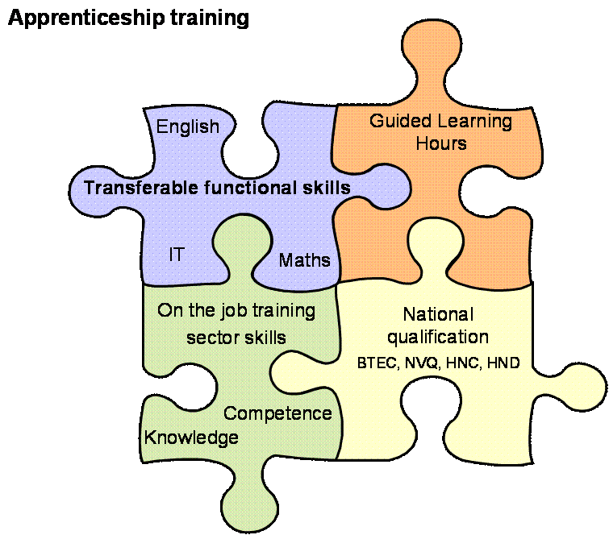
What goes into an apprenticeship
Notes:
Every apprenticeship not only brings you ‘academic’ but employer (-led) recognised qualifications… plus relevant work experience plus a rich variety of transferable skills
All qualifications are industry standard - approved by the relevant sector (employer skills body, Sector Skills Councils) and comprise of:
Technical Knowledge qualifications showing achievement of the technical skills, knowledge and understanding of theoretical concepts. And the required knowledge and understanding of the industry and its market, relevant to the skill, trade or occupation
These may be separate or in some apprenticeship framework levels combined with Competence Qualifications – which demonstrate appropriate levels of competence in performing the skills, trade or occupation
In apprenticeship frameworks to Level 3 modules for transferable skills and qualifications are mandatory. These comprise of:
* Functional Skills – English, Maths and (where appropriate to the role) Information Technology
* ERR – Your Employee Rights and Responsibilities, including awareness of:
How your role fits within + benefits your organisation & industry; personal health & safety, etc.
An informed view of the types of career pathways that are open to you
* Personal Thinking and Learning Skills – Growing your personal capacity to develop skills such as independent enquiry, creative thinking, reflective learning, team working, self management and effective participation
* GLH - Specified numbers of Guided Learning Hours spent in on-the-job and off the job training

Slide 10
What about higher education?
  Apprenticeships go up to degree level and beyond
  Level 4 (Certificate of Higher Education)
  Level 5 (Foundation Degree)
  Level 6 (Bachelor’s Degree)
  Level 7 (Master’s Degree)
Notes:
Speaker notes:
Due to demand from business and backing from the government Higher and degree level Apprenticeships are expanding. Apprentices’ opportunities for career progression are increasing with the expansion of Higher and degree level Apprenticeships (levels 4-7). Equivalent to a degree, more of these specialised and highly skilled apprenticeships are being offered each year, giving individuals the chance to continue their professional development and realise their full potential.

Slide 11
How do I apply for an apprenticeship?
Notes:
Speaker notes:
Applying for an apprenticeship is no different to applying for any other job, you should consider what your long term career goals are and how best to reach them then look for an apprenticeship vacancy to get you started on the path to your dream career.

Slide 12
Find an apprenticeship
There are up to 27,000 vacancies available on the site at any one time
Notes:
Speaker notes:
There are up to 27,000 vacancies on the ‘Find an apprenticeship’ vacancy site at any one time

Slide 13
Apprenticeship vacancies
Follow the following 5 easy steps to get started:
Log on to www.gov.uk/apply-apprenticeship
Click ‘Search the fine an apprenticeship service’ to start searching. You can search using keywords, job title, employer, vacancy reference number or by postcode, town, city
Click ‘Sign in’ under ‘Create an account’. Fill in your details and create your username and password
When you register for the first time you’ll get a confirmation email, enter the 6 digit code to activate your account
Once you have found a position you want applying is easy, use the reusable application form.
For any assistance using the job site call 08000 150 400
Notes:
Speaker notes:
There are 5 easy steps to search and register on the Find an apprenticeship system to begin your search for your ideal job.
Presenter guidance (see pack 2 - Find an apprenticeship, which gives in-depth guidance on the registration process)
Traineeship opportunities are available on the ‘Find a Traineeship’ section of the gov.uk website.

Slide 14




Slide 15
Summary
You can now:
Discover and explore all about apprenticeships and how to to be an apprentice yourself!

Slide 16
Further information
If you would like further information about apprenticeships please visit www.apprenticeships.gov.uk
To see the current jobs available please visit www.gov.uk/apply-apprenticeship
For further assistance you can view the film ‘How to apply for an Apprenticeship’ which provides a step by step guide through the vacancies service and explains what applicants can expect at every stage of the process.
If you would like further advice on what apprenticeship to do or other career choices contact nationalcareersservice.direct.gov.uk or call 0800 100 900

Slide 17
Any Questions?

