Slide 1


Apprenticeship Funding

Slide 2

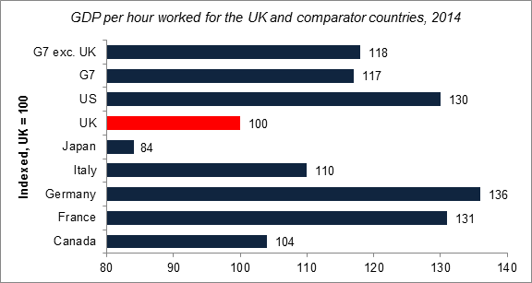
Action is needed to address current economic trends
UK productivity lags behind other developed economies…
… and employers are investing less in training
…and employers are investing less in training
Number of employees who worked fewer hours than usual because they attended a training course away from their workplace
Meanwhile… relative social mobility has stagnated or declined over recent decades
The UK has low levels of intergenerational social mobility compared to some other developed countries
2
Notes:
Source GDP chart= ONS, International Comparisons of Productivity, 2014.

Slide 3
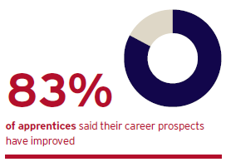
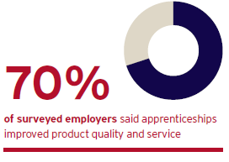
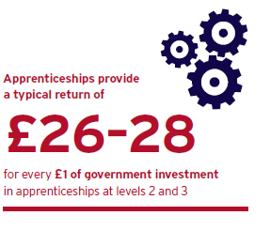
Apprenticeships contribute to addressing these challenges
That’s why the government is committed to significantly increasing the quantity and quality of apprenticeships in England and achieving 3 million starts by 2020.
Benefits
Apprentices complete their apprenticeship with highly marketable skills…
…that make it more likely for them to remain employed, including with the same employer.
Employers experience tangible improvements to their product or service as a result of apprenticeships.
Apprenticeships create real benefits for the taxpayer and the wider economy…
…and contribute to the Government’s overall goal of improving labour market outcomes.

Slide 4
But the programme could be bigger and better
Individual apprenticeships provide good returns, but there is an insufficient number of apprenticeship opportunities to meet demand from individuals, and skills gaps remain in the economy.
Whilst the vast majority of apprenticeships provide high quality training, feedback from employers shows that this is not always the case. We need to continue to drive up the quality of apprenticeship training and ensure that anyone completing an apprenticeship is fully competent in their occupation.
Ambitious Government reforms:
Employers at the heart of designing new Apprenticeships Standards to replace apprenticeship frameworks by 2020.
New Institute for Apprenticeships led by employers to oversee standards and ensure quality and rigour
Apprenticeships given equal legal protection to degrees
Apprenticeship target for public sector bodies – duty for 2.3% of workforce to be apprentices will grow opportunities
Secondary Class 1 NICs abolished for apprentices under the age of 25 since April 2016
All underpinned by changes to how apprenticeships are paid for. New apprenticeship levy paid by 2% of employers will fund expansion. Digital Apprenticeship Service will enable employers to directly manage their apprenticeship programmes and purchase training.

Slide 5
Funding reform
Lots of information about the new funding system has already been confirmed
Here’s a recap…

Slide 6
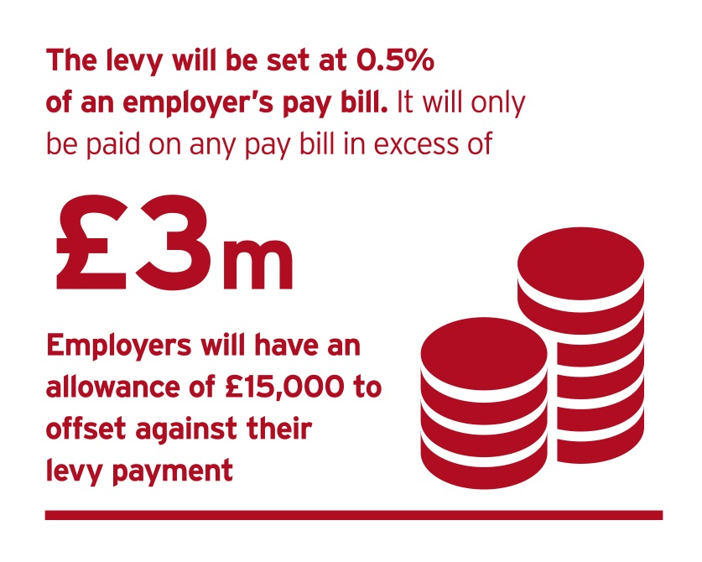
What is the apprenticeship levy and who pays it?
Levy on UK employers will fund growth in the apprenticeship programme. In parallel, employers will be given more influence over how apprenticeships are designed and paid for, so that they focus on the skills, knowledge and behaviours that are required of the workforce of the future.
Growth in apprenticeships will open up opportunities to individuals from all backgrounds and all parts of the country, giving more people the chance to pursue a successful career.
The levy will come into effect on 6 April 2017, at a rate of 0.5% of pay bill, paid through PAYE. It applies to all employers in all sectors.
All employers have an allowance of £15,000 to offset against their levy liability. The levy allowance is not a cash payment and cannot be used to purchase apprenticeship training
The allowance means that only UK employers with
an annual pay bill of more than £3 million
  Are liable to pay the levy. That’s 2% of employers.
Employers in England who pay the
  levy will be able to get out more than
  they pay into the levy, through
  a 10% top-up to their digital accounts

Slide 7
Paying the levy
How?
Employers will calculate, report and pay their levy to HMRC, through the Pay As You Earn (PAYE) process alongside income tax and National Insurance.
Single employers with multiple PAYE schemes will only have one allowance.
Connected employers - we intend to allow employers to share one allowance between employers which are in connected ownership or control.
Employers will not be exempt from the apprenticeship levy if they already pay into an existing levy.
LEVIED EMPLOYER
NON-LEVIED EMPLOYER
Employer of 250 employees, each with a gross salary of £20,000.
Pay bill: 250 x £20,000 = £5,000,000
Levy sum: 0.5% x £5,000,000 = £25,000
Allowance: £25,000 - £15,000 =
  £10,000 annual levy payment
Employer of 100 employees, each with a gross salary of £20,000.
Pay bill: 100 x £20,000 = £2,000,000
Levy sum: 0.5% x £2,000,000 = £10,000
Allowance: £10,000 - £15,000 =
  £0 annual levy payment

Slide 8
Accessing levy funds to spend on training
Levy funds will be available through a new digital service on gov.uk
Once registered for the new digital service, levied employers will be able to select their PAYE schemes and access funds available to them as a result of their levy payments.
This will allow employers with multiple PAYE schemes and connected companies to aggregate levy funds into one account on the service.
Employers will be able to see their levy contributions coming into the account monthly and accumulating over time.
Funds will first appear in account in late May 2017 after the employer has completed their RTI submission for April 2017.
How funds in the account will be calculated
To calculate how much each employer will have to spend through the English system, we are proposing to use data that HMRC already hold about the proportion of each employer’s pay bill paid to employees living in England.
For example:
  If 100% of pay bill is in England → 100% of levy payment in digital account
  If 80% of pay bill is in England → 80% of levy payment in digital account
Employers will benefit from a 10% govt top up to monthly funds entering an account.
Funds will expire 18 months after they appear in the employer’s digital account unless they are spent on apprenticeship training. This will also apply to any top-ups in their digital account.

Slide 9
Purchasing training
The new funding system comes into effect on 1 May 2017, because May is the first month that levy paying employers will declare a levy payment to HMRC. All apprenticeships started before 1 May will be funded through to completion according to the existing rules. Any employer contribution towards training commenced before 1 May will also continue at the current rate.
Levied employers buying training from May 2017
Employers can commit to apprenticeship starts from the beginning of May after selecting a provider and an apprenticeship programme. By committing to apprenticeship training via the digital account, the employer will be entering into a contract agreement with the provider.
Once committed to training, funds will automatically leave the employer’s digital account on a monthly basis, spread over the lifetime of the apprenticeship.
We propose to hold back 20% of the total cost, to be paid on completion of the apprenticeship.
Information and tools in the digital account will help employers forecast the funds that are likely to accumulate in their account over time and manage cash flow.
Non-levied employers buying training from May 2017
Employers that don’t pay the levy will make payments for training direct to providers. We will move them onto the digital system at a later date.

Slide 10
Purchasing training
Digital funds and government funding can be used for:
  apprenticeship training and assessment
  against an approved framework or standard
  with an approved training provider and assessment organisation
  up to the funding band maximum for that apprenticeship
Digital funds and government funding can not be used for:
  wages
  travel and subsistence costs
  managerial costs
  traineeships
  work placement programmes
  the costs of setting up an apprenticeship programme

Slide 11
How the funding system will work
10% Top up
Levy paying employer
HMRC collect levy (PAYE)
Employer views funds in digital account to spend in England
Employs apprentice and commits to training
Receives training for apprentice
Payments to providers taken from digital account
Unused funds expire after 18 months
Employs apprentice and commits to training
Receives training for apprentice
Employer pays for proportion of cost direct to training provider
SFA pays govt proportion of costs to the training provider
Non-levIED employer
Registers with SFA
Commits to provide apprenticeship training
Provides training to apprentice
Provides info via ILR to SFA that training has taken place & that employer has made contribution
Paid by SFA and balance by employer
Training
Provider
Pass data on levy payments from HMRC to DfE
Timely data on training
Check training is complete
If funding unlocked: pay provider
Government
Employer and Provider Identity Assurance

Slide 12
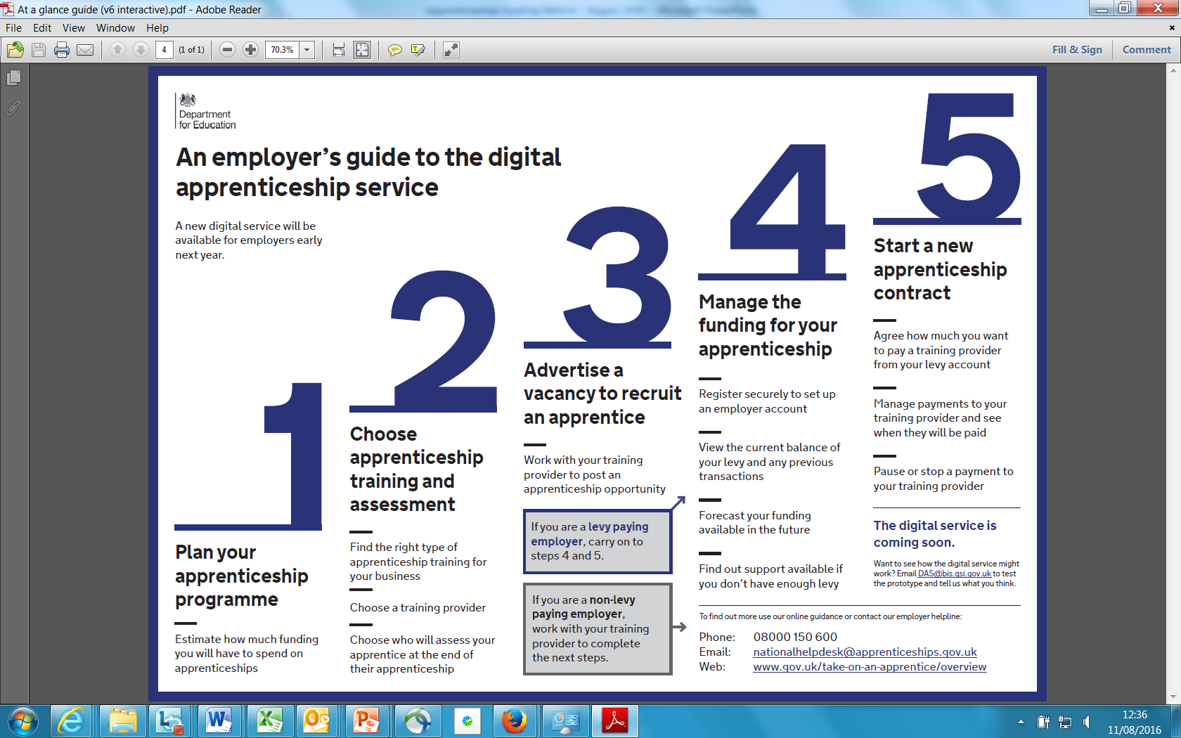
The Digital Apprenticeship Service
NOTE
Employers who don’t pay the levy will not need to use the digital apprenticeship service to pay for apprenticeship training and assessment until at least 2018. When we ask them to start using the digital apprenticeship service to pay for apprenticeship training, we will help them to prepare.

Slide 13
Funding reform – more details
On 12 August, Government published further proposals on detailed funding model
Inviting employers and providers to feedback
by 5 September

Slide 14
Provisional funding bands
Number | Band limit
1 | £1,500
2 | £2,000
3 | £2,500
4 | £3,000
5 | £3,500
6 | £4,000
7 | £5,000
8 | £6,000
9 | £9,000
10 | £12,000
11 | £15,000
12 | £18,000
13 | £21,000
14 | £24,000
15 | £27,000
Why? Setting limits on the amount of government or digital funds that can be used for a single apprenticeship supports quality training whilst ensuring apprenticeships are affordable for individual employers and deliver value for taxpayers.
Every apprenticeship will be placed in a funding band
All existing and new apprenticeship frameworks and standards will be placed within one of these funding bands. This will depend on the level and type of apprenticeship.
The upper limit of each funding band will cap the maximum amount of digital funds an employer who pays the levy can use towards an individual apprenticeship.
The upper limit of the funding band will also cap the maximum price that government will ‘co-invest’ towards, where an employer does not pay the levy or has insufficient digital funds and is eligible for extra support.
Employers can negotiate the best price for the training they require
Employers will be able to negotiate prices with providers.
If employers want to spend more than the funding band limit, using their own money, then they will be free to do that.
Funding bands do not have a lower limit.

Slide 15
Provisional funding bands for frameworks
Current system
Government funds apprenticeship frameworks at different rates depending on the age of the learner. In future we will be putting funding in the hands of employers and the system needs to be simple for them to navigate, choose the apprenticeship training they want to purchase and negotiate on price. That means we have to simplify some of the complex funding arrangements that currently exist, while retaining the right incentives for high quality training.
Proposals
We propose to allocate each individual framework pathway to a single funding band, regardless of the age of the learner, or geographic location. This will bring frameworks into line with the funding system for apprenticeship standards and dramatically simplify the experience of employers.
We propose to allocate individual framework pathways to the nearest funding band based on the current rate of funding the government pays providers for training adult apprentices.
For all STEM framework pathways we propose to increase the current government-funded adult rate by 40% at Level 2 and 80% at Level 3 and above, and then allocate these frameworks to the nearest funding band. This uplift takes into account the fact that employers of these apprentices are currently disproportionately likely to be paying extra to providers on top of the funding provided by government.
For this purpose, we propose to determine STEM frameworks by sector subject area. There are thirteen sector subject areas and we propose to apply the uplifts to: Engineering and Manufacturing Technologies; Information and Communication Technology; Science and Mathematics; and Construction, Planning and the Built Environment.
We invite feedback from employers and providers about this proposal, including how STEM should be defined.

Slide 16
Provisional funding bands for standards
Current system
Currently, standards are paid for through a combination of government and employer funding. The government pays two-thirds of the cost and employers are required to pay one-third, and the maximum total core funding for the most expensive standard in the highest funding band is £27,000.
Proposals
Apprenticeship standards are employer-designed and offer employers and apprentices a more robust and relevant training experience. This is recognised in the current funding system and we will recognise it in the new system by allocating higher funding bands to apprenticeship standards, relative to equivalent frameworks, where appropriate.
We propose that existing apprenticeship standards are allocated to new funding bands according to the following principles:
Lower cost standards should be allocated to the new funding band that most closely aligns with the current funding band the standard is assigned to. For example, all standards in the current band 2 (maximum of £4,500 total core funding) will be allocated to the proposed new band 5, which has an upper limit of £5,000.
Those standards currently assigned to the widest and highest cost funding band, which ranges from £12,000 to £27,000, will be allocated to a new band within this range. When identifying where individual standards should fit within this range we have taken into account:
  Where there have been starts on standards and we have reliable data, the actual prices employers have negotiated with providers.
  The evidence originally presented by Trailblazer employers on the estimated costs of training, and taking into account only those costs which are eligible for public funding according to the existing funding rules.
  The funding bands set for equivalent frameworks, where comparisons exist.
  The level and nature of the training, and consistency across similar types of apprenticeship standard.
We invite feedback from employers and providers on these proposals, which aim to support quality apprenticeship starts whilst ensuring value for money and that apprenticeships are accessible to employers of all sizes.

Slide 17
Co-Investment
There are two types of employers who will be benefit from government support towards the cost of their apprenticeships training:
  Employers who haven’t paid the levy and want to purchase apprenticeship training from a provider
  A levy-paying employer who with insufficient funds in their digital account to pay for the cost of training and assessment they want to purchase
We propose that:
The government pays 90% of the costs of training and assessment.
The employer will be responsible for paying 10% of the costs.

Slide 18
WITHIN THE FUNDING BAND LIMIT
OVER THE FUNDING BAND LIMIT
Funding limits– how they work
Example funding band limit = £6,000
Price you negotiate with your training provider = £5,000
The cost is within the funding band limit
Example funding band limit = £6,000
Price you negotiate with your training provider = £7,500
The cost is above the funding band limit
With enough funding in your account
Without enough funding in your account
With enough funding in your account
Without enough funding in your account
£5,000 will be deducted from your digital account over the life of the apprenticeship.
If you have £0 in your account we will pay 90% (£4,500) and you will need to pay 10% (£500).
If you have digital funds available, these will be used first, and then we will pay 90% of the remaining costs, and you will pay 10%.
£6,000 will be deducted from your digital account over the life of the apprenticeship.
You will be responsible for paying £1,500. This payment can’t be made from your digital account
If you have £0 in your account we will pay 90% (£5,400) and you will need to pay 10% (£600). This is the maximum payable within the limit of the band.
You will also be responsible for paying the additional £1,500. This payment can’t be made from your digital account

Slide 19
Additional support for small employers
Current system
We recognise that taking on an apprentice is a big step for many small employers. We also know that smaller employers have historically played a very important role in helping young and disadvantaged people into the workforce for the first time. We currently recognise this by paying a grant to small employers to support them in taking on new apprentices aged between 16-24 years of age. This is called the Apprenticeship Grant for Employers 16-24. The AGE grant scheme will continue until the end of the 2016/17 academic year.
Proposals
We want to continue to support small employers to take on younger apprentices and so propose that employers with fewer than 50 people working for them will be able to train 16 to 18 year old apprentices at no cost. The government will pay 100% of the apprenticeship training costs for these individuals.
We propose to extend this to small employers who take on a 19 to 24 year old apprentice who was formerly in care or has a Local Authority Education, Health and Care plan. The government will pay 100% of the apprenticeship training costs for these individuals.

Slide 20
Need to format with headings
WITHIN THE FUNDING BAND LIMIT
OVER THE FUNDING BAND LIMIT
Funding limits– how they work
Example funding band limit = £6,000
Price you negotiate with your training provider = £5,000
The cost is within the funding band limit
The training is for a 16-18 year old apprentice
Example funding band limit = £6,000
Price you negotiate with your training provider = £7,500
The cost is above the funding band limit
The training is for a 16-18 year old apprentice
Employer of under 50 people
Employer of under 50 people
Government will fund 100% of the cost within the funding band limit of apprenticeships training and assessment for employers who employ fewer than 50 people.
In this case:
We will pay 100% (£5,000)
You will pay 0% (£0).
Government will fund 100% of the cost within the funding band limit of apprenticeships training and assessment for employers who employ fewer than 50 people.
In this case:
We will pay 100% of £6,000
You will pay 0% of £6000
You will be responsible for paying in full the amount above the funding band limit (£1,500).

Slide 21
Additional support for apprentices
Funding for 16-18 year olds
Government proposes to pay £1,000 to employers, and a further £1,000 to training providers if they train a 16-18 year old apprentice.
We propose to help with the extra costs of supporting these individuals so that everyone has the opportunity to benefit from an apprenticeship. Employer funding will be paid through the training provider.
Disadvantaged young people
Government proposes to pay £1,000 to employers, and a further £1,000 to training providers if they train 19-24 year olds leaving care or who have a Local Authority Education and Healthcare plan.
We propose to help with the extra costs of supporting these individuals so that everyone has the opportunity to benefit from an apprenticeship. Employer funding will be paid through the training provider.
Funding for additional learning support
This is the extra amount that we propose to pay to the training provider where an apprentice requires additional learning support as a result of conditions such as dyslexia, learning difficulties or disabilities. We propose to pay training providers up to £150 a month to support these learners, plus additional costs based on evidenced need. This is a continuation of the current system.
Funding for English and Maths training
The government is committed to helping apprentices gain the minimum standard of Level 2 in English and maths.
When employers agree with their training provider that their apprentice needs training to meet the minimum standards in English and maths we propose to pay training providers £471 for each of these qualifications (Level 1 and 2).
This will come direct from the government and will not be deducted from an employer’s digital account.

Slide 22
Funding rules
Transferring funding
During 2018, subject to a final value for money assessment, we propose to introduce means for employers to transfer up to 10% of the levy funds entering their digital account in a given year, to another employer with a digital account, or to an ATA.
We will assess the impact and effectiveness of these arrangements before considering how they could be expanded.
Prior qualifications
Employers will be able to use funds in their account or access government co-investment support to train any individual to undertake an apprenticeship at a higher level than a qualification they already hold.
In addition, we propose that an individual can be funded to undertake an apprenticeship at the same or lower level than a qualification they already hold, if the apprenticeship will allow the individual to acquire substantive new skills and the content of the training is materially different from any prior training or a previous apprenticeship.
Cross-border funding
The current apprenticeship funding rules place conditions on which individuals can be funded to undertake an apprenticeship through the English system. We propose to simplify the current rules and apply a single test for whether apprenticeship training can be funded through the English system: based on whether the apprentice’s main place of employment is England.
We propose that the definition of workplace is the physical place of work, designated by the employer, where the apprentice is expected to spend the majority of their time during their apprenticeship. We welcome feedback from employers on whether this is an appropriate test to apply to eligibility for funding.
We are continuing to engage with the Devolved Administrations on the scope for reciprocal funding arrangements for employees who live in England but who may work elsewhere in the UK.

Slide 23
Next Steps
In August we published apprenticeship funding proposals. We are inviting feedback on these proposals and will use the summer to test them further, including how they support the government’s emerging industrial strategy and ensure that individuals from all backgrounds and parts of the country have the opportunity to get on in life.
You can provide feedback here by 5 September 2016.
October 2016
The final funding bands that will apply in the new system
The final, full set of technical rules that underpin the funding system
Confirmation of how the proportion of pay bill that is paid to employees living in England will be calculated
December 2016
Further employer guidance from HM Revenue and Customs (HMRC) on how to calculate and pay the apprenticeship levy

Slide 24
ANNEXES

Slide 25


Slide 26


Slide 27
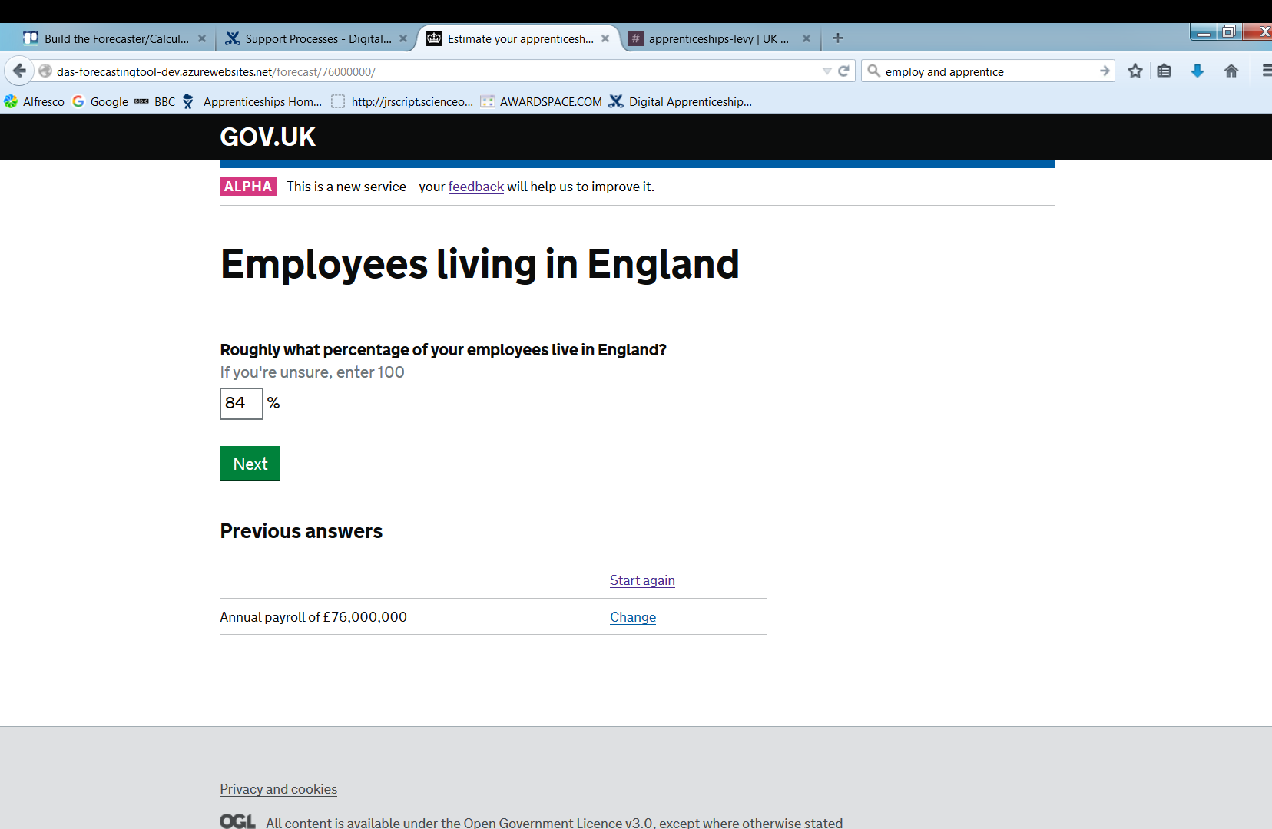

Slide 28
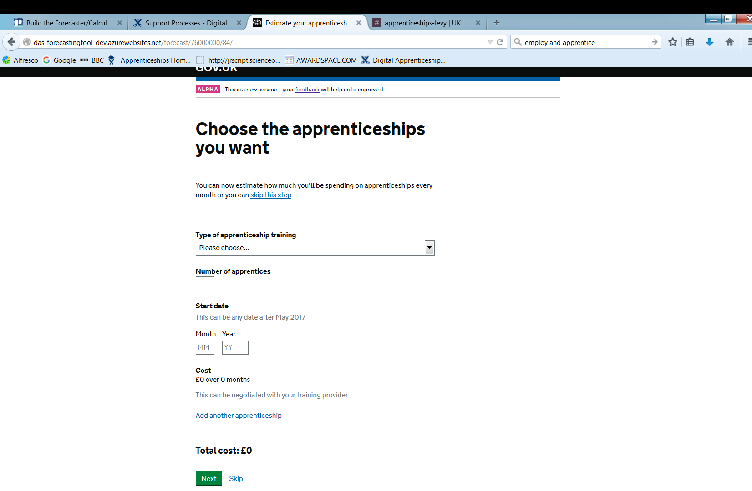

Slide 29
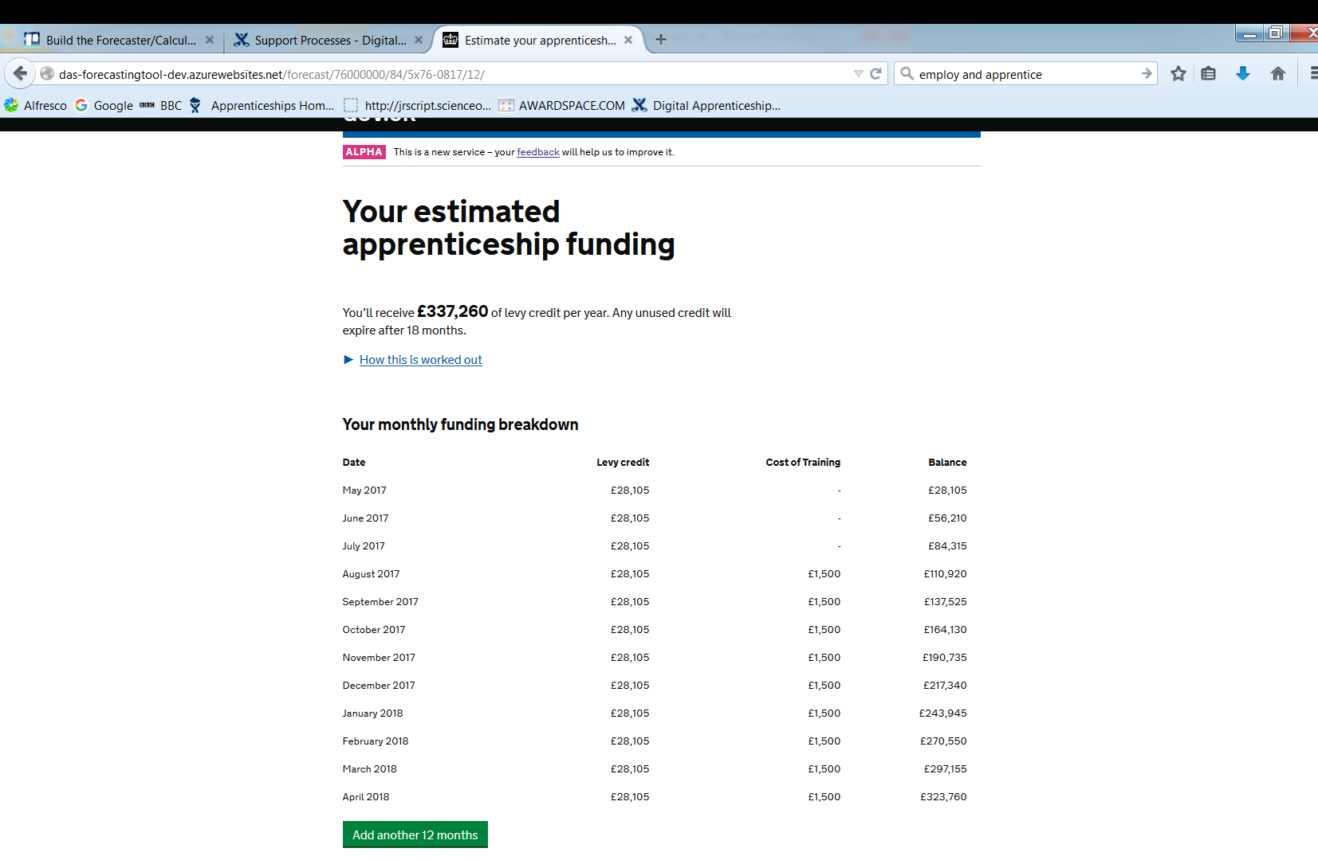

Slide 30
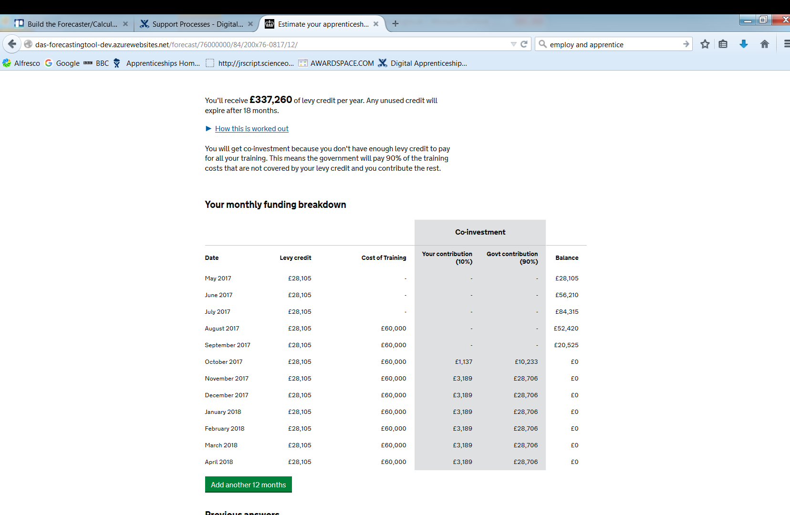

Slide 31
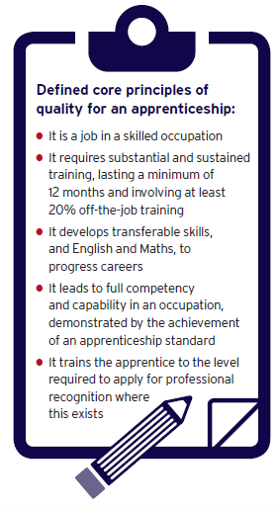
Apprenticeship Standards: What are they?
Employers are designing apprenticeship standards to meet the needs of their industry through the Trailblazer programme
A standard should:
be short, concise and clear
set out the full competence needed in an occupation in terms of Knowledge, Skills and Behaviour (KSBs)
have the support of employers including smaller businesses
be sufficiently stretching to require at least a year of sustained and substantial training to meet
align with professional registration where it exists
contain minimum English and maths requirements and
only include mandatory qualifications under certain circumstances.

Slide 32

Trailblazer progress so far
Over 170 Trailblazers currently developing over 400 standards.
Over 40% are higher/degree level
246 standards have been published
Guidance available at: https://www.gov.uk/government/publications/future-of-apprenticeships-in-england-guidance-for-trailblazers
List of standards developed / in development so far available at: https://www.gov.uk/government/publications/apprenticeship-standards-list-of-occupations-available

Slide 33
Institute for Apprenticeships
An independent employer-led body that will regulate the quality of apprenticeships, set up by April 2017 (shadow form with effect from 2016)
An independent Chair will lead a small Board comprised primarily of employers, business leaders and their representatives.
Antony Jenkins (ex-Barclays) and Nicola Bolton (ex-UKTI) appointed shadow chair and shadow chief operating officer in June 2016
Outline role:
  Approve/reject Expressions of Interest, standards and assessment plans
  Provide advice and guidance during their development
  Maintain a public database of apprenticeship standards and publish information illustrating potential gaps
  Advise on the maximum rate of Government funding that should be assigned to each standard

Slide 34
Devolved Administrations
If you’re an employer with operations in Scotland, Wales or Northern Ireland, you may also want to contact their apprenticeship authority
Scotland
https://www.apprenticeships.scot/
Wales
https://businesswales.gov.wales/skillsgateway/apprenticeships
Northern Ireland
https://www.nidirect.gov.uk/campaigns/apprenticeships

