Slide 1
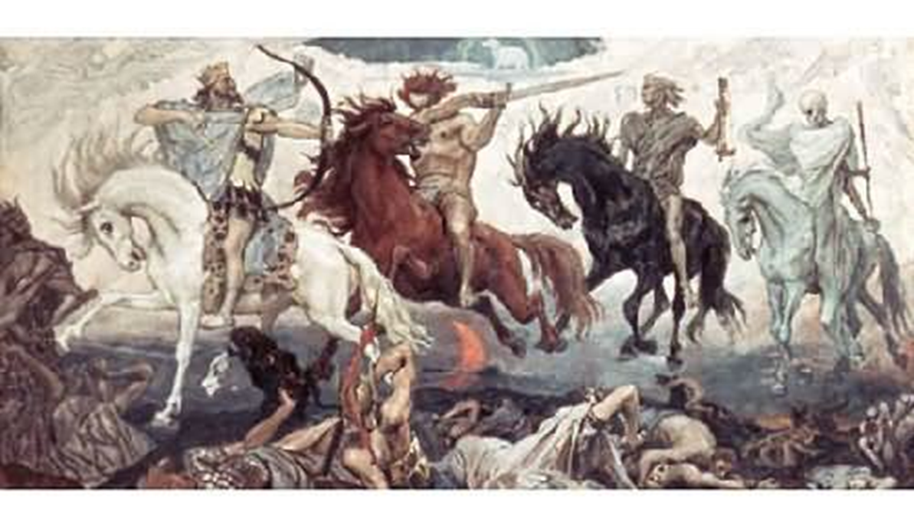

Slide 2
GDPR - Individual’s Rights
To be informed
Access
Rectification
Erasure
Limited Processing
Data Portability
Objections
Profiling

Slide 3
Accountability & Governance
•Implement appropriate technical and organisational measures that ensure and demonstrate that you comply. This may include internal data
protection policies such as staff training, internal audits of processing activities, and reviews of internal HR policies.
•Maintain relevant documentation on processing activities.
•Where appropriate, appoint a data protection officer.

Slide 4
Information Held
Document what personal data we hold, where that data came from and who it is shared with.
Conduct an information audit across the organisation to map data flows.
Maintain internal records of processing activities.
Document what personal data we hold, where it came from and who we share it with.

Slide 5
Data Protection By Design
Implement appropriate technical and organisational measures to show considered and integrated data protection into all processing activities.
· A description of the processing operations and the purposes including, where applicable, the legitimate interests pursued by the controller.
· An assessment of the necessity and proportionality of the processing in relation to the purpose.

Slide 6
Lawful Basis / Consent
Document what personal data is held, where that data came from and who it is shared with.
Conduct an information audit across the organisation to map data flows.
Review how Consent is sought, recorded and managed.
Consent means offering people genuine choice and control over how their data is used.

Slide 7
Subject Access Requests
Review procedures and have plans in place on how to handle requests from individuals for access to their personal data within 30 days.
In most cases you are not able to charge for complying with a request.
You can refuse or charge for requests that are manifestly unfounded.
Excessive requests can also be charged for or refused.
Where you refuse to respond to a request, you must explain why to the individual, informing them of their right to complain to the supervisory authority.
.

Slide 8
Data Breaches
The GDPR introduces a duty on all organisations to report certain types of data breach to the ICO and in some cases to individuals.
You have to notify the ICO of a breach where it is likely to result in a risk to the rights and freedoms of individuals. If unaddressed, such a breach is likely to have a significant detrimental effect on individuals – for example, it could result in discrimination, damage to reputation, financial loss, loss of confidentiality or any other significant economic or social disadvantage.

Slide 9
Transfer of Data Outside of Organisation
You may transfer personal data where the organisation receiving the personal data has provided adequate safeguards.
Individuals’ rights must be enforceable and effective legal remedies for individuals must be available following the transfer.

Slide 10


